Slide 1

Portfolio
Sit Dolor Amet

Slide 2
Title: "Portfolio Project: Personal Profile Page"
Subtitle: "Created with HTML & CSS"
Name: NAINI ABHISHEK
Contact Info:
Email: abhiram991244@gmail.com
LinkedIn: http://linkedin.com/in/abhisheknaini0411

Slide 3
Introduction
Title: "About the Project"
Content:
"This project is a personal profile page built using HTML and CSS. It showcases my skills, projects, and contact information in an engaging and user-friendly layout."
Technologies Used: HTML, CSS, Fonts: Poppins, Icons: FontAwesome.

Slide 4
Project Goals
"The goal was to create a visually appealing and responsive personal profile page."
Key goals:
Display personal information (skills, contact, portfolio).
Use modern design principles.
Ensure full responsiveness across devices.

Slide 5
Project Goals
Title: "Project Goals"
Content:
"The goal was to create a visually appealing and responsive personal profile page."
Key goals:
Display personal information (skills, contact, portfolio).
Use modern design principles.
Ensure full responsiveness across devices.

Slide 6
Features of the Project
Title: "Key Features"
Content:
"Here are the key features of my personal profile page:"
Personal profile section with a circular image.
Social media icons (LinkedIn, Email) for easy contact.
Skills section with a bullet list of key skills.
Portfolio section linking to previous projects.
Contact form to message me directly.

Slide 7
Code Snippets
Title: "Key Code Snippets"
Content:
HTML: Example of the structure for your contact form:
html
<form> <label for="name">Name:</label> <input type="text" id="name" name="name" placeholder="Your Name"> <!-- More form fields here --> <button type="submit">Send Message</button> </form>
CSS: Example of styling for social icons:
css
.icon-link:hover { transform: scale(1.1); color: #fff; }

Slide 8
Design & Aesthetics
Title: "Design Approach"
Content:
"For the design, I focused on a clean and minimalist layout, using a bright color palette and clear typography."
Key design choices:
Font: Poppins (modern and readable).
Color scheme: Gradient header/footer with vibrant colors.
Image: Circular profile image with a subtle shadow effect.
Layout: Center-aligned sections for clarity and ease of use.

Slide 9
Challenges & Solutions
Title: "Challenges & Solutions"
Content:
"During development, I encountered a few challenges:"
Challenge 1: Aligning the contact form fields correctly.
Solution: Used Flexbox to ensure proper alignment.
Challenge 2: Making the page fully responsive across different screen sizes.
Solution: Implemented media queries to adjust layout based on screen width.

Slide 10
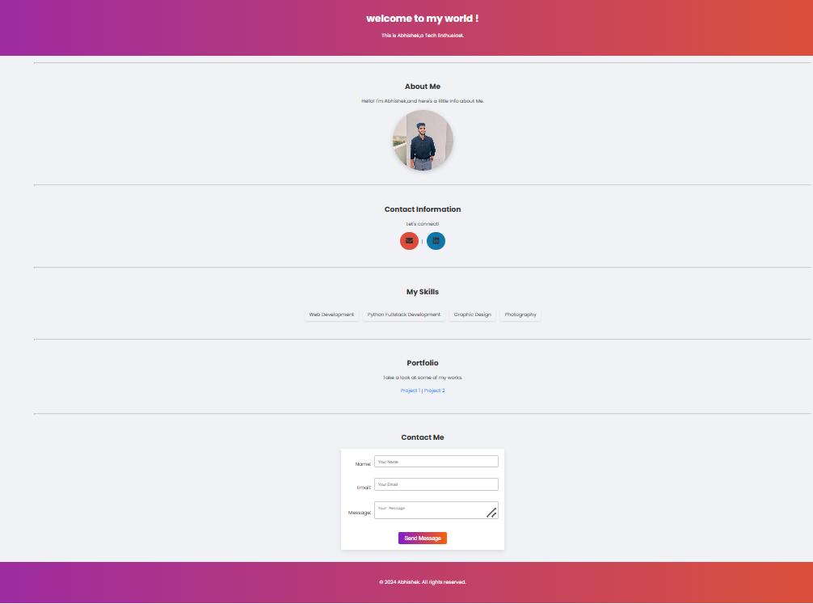
Demo / Live Project

Slide 11
Conclusion
Title: "Conclusion"
Content:
"This project helped me improve my HTML and CSS skills, and I learned how to implement responsive design."
Future Improvements: "I plan to add JavaScript functionality for interactive elements and improve accessibility."

Slide 12
Contact Information
Title: "Contact Me"
Content:
Email: abhiram991244@gmail.com
LinkedIn: http://linkedin.com/in/abhisheknaini0411
"Feel free to reach out for collaborations, feedback, or questions!"

